Slide 1
SOLID Design Principles

Slide 2
SOLID Principles
There are five SOLID principles.
Single Responsibility Principle (SRP)
Open Closed Principle (OCP)
Liskov Substitution Principle (LSP)
Interface Segregation Principle (ISP)
Dependency Inversion Principle (DIP)
Used to make software design more understandable, flexible, and maintainable.

Slide 3
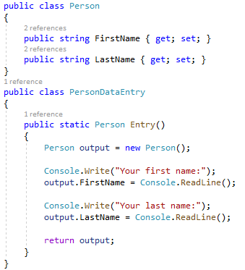
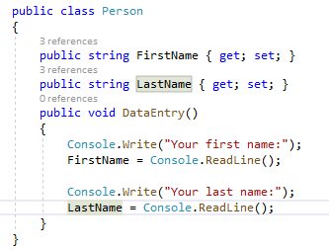
Single Responsibility Principle (SRP)
A class should only have a single responsibility.
If a class has two reasons to change, then it should be split into two classes.

Slide 4
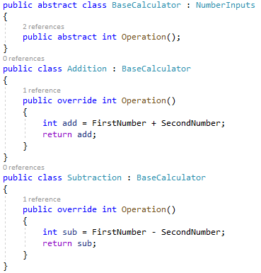
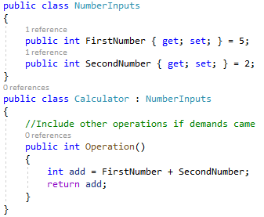
Open Closed Principle (OCP)
Software entities (classes, modules, functions, etc.) should be open for extension, but closed for modification.

Slide 5
Liskov Substitution Principle (LSP)
Objects in a program should be replaceable with instances of their subtypes without altering the currectness of that program.
Parent classes can be substituted with their subclasses or derived classes.
They’re interchangeable.
This principle is just an extension of the Open Closed Principle and it means that we must ensure that new derived classes extend the base classes without changing their behavior.

Slide 6
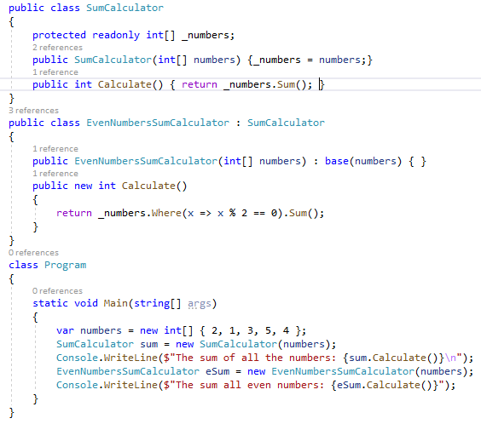
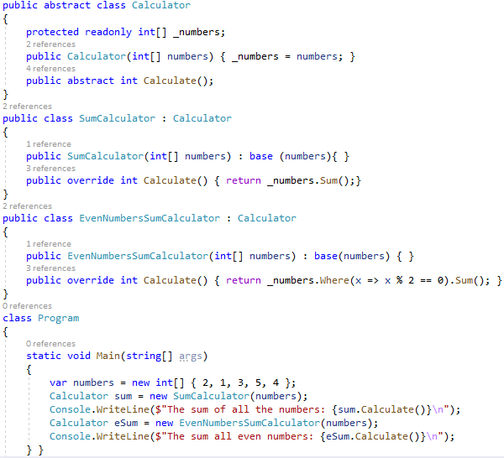

Slide 7
Interface Segregation Principle (ISP)
Many client-specific interfaces are better than one general-purpose interface.
No application should be required to relay on methods it won’t use.
Broken the big interface into useful small interfaces.

Slide 8
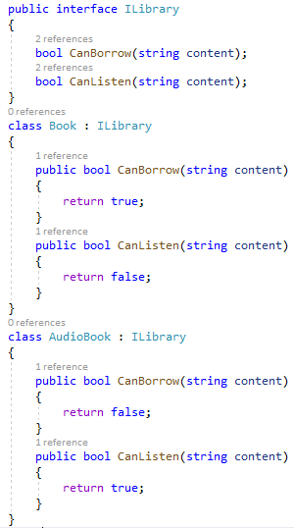
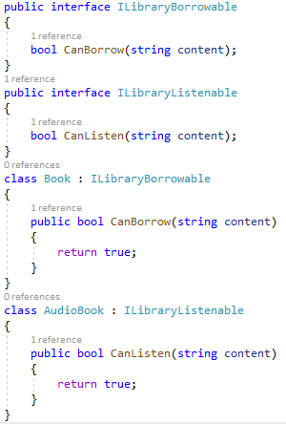

Slide 9
Dependency Inversion Principle (DIP)
High-level modules should not depend on low-level modules. Both should depend on abstractions.
Abstractions should not depend on details. Details should depend on abstractions.

Slide 10
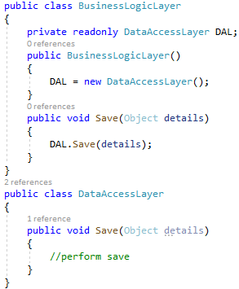
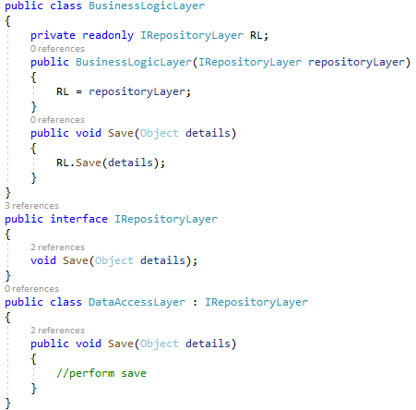

Slide 11
THANK YOU

